Slide 1

INTRUSION DETECTION SYSTEM
MINOR PROJECT
USING MACHINE LEARNING MODELS
ARPIT CHACHANE 171112019
ANANYA SHRIVASTAVA 171112032
ANUJ SHRIVASTAV 171112033
BHAVESH LOHAR 171112044

Slide 2
What is an Intrusion Detection System?
Let’s break it down
INTRUSION
+
DETECTION
+
SYSTEM
Any malicious activity or an attack in the network or a computer
An activity of detecting the attacks
A system or a software that enables us to perform Intrusion Detection

Slide 3
IDS vs Firewall : A common question
Firewall uses a static set of rules to permit or deny network connections. It detects intrusions from outside the network
On the other hand, IDS can detect intrusions from the within the network as well.

Slide 4
Types of IDS on the basis of their location
The most common classifications is
1) Network intrusion detection systems (NIDS)
A system that analyses the whole network traffic
2) Host-based intrusion detection systems (HIDS)
A system that analyses the operating system files

Slide 5
Types of IDS based on their functionality
Signature-based intrusion detection — These systems compare the incoming traffic with a pre-existing database of known attack patterns known as signatures.
If we use this, detecting new attacks is difficult.

Slide 6
Types of IDS based on their functionality
2) Anomaly-based intrusion detection — It uses statistics to form a baseline usage of the networks at different time intervals. They were introduced to detect unknown attacks. This system uses machine learning to create a model monitoring regular activity and then compares new behaviour using the existing model.

Slide 7
A brief introduction to machine learning
Machine Learning is the field of study that gives computers the capability to learn and improve from experience without being programmed explicitly.
The process of learning begins with observations or data to look for patterns in data and make better predictions based on the examples provided.

Slide 8
Types of learning
Learning
Most of the work
Very less work
Less work
Reinforcement
Supervised
Unsupervised
Makes use of class labels to learn from data e.g. classification problem or a regression problem
Computer uses trial and error method to learn the best path possible to reach the goal state.
e.g. game playing
Class labels are not available with the data and learning is done by grouping similar items into the same group
e.g. clustering

Slide 9
Stages in a machine learning project
Define ML problem
Acquire data
&
explore
Transform the data
Apply ML models
Test your model

Slide 10
Dataset for IDS
Classical dataset for IDS which is readily available and widely used is KDD Cup -1999 dataset.
Since the competition, the dataset is being used as the primary dataset for almost every IDS research
The dataset is being acquired by Kaggle website which is a repository for all data science related stuff.

Slide 11
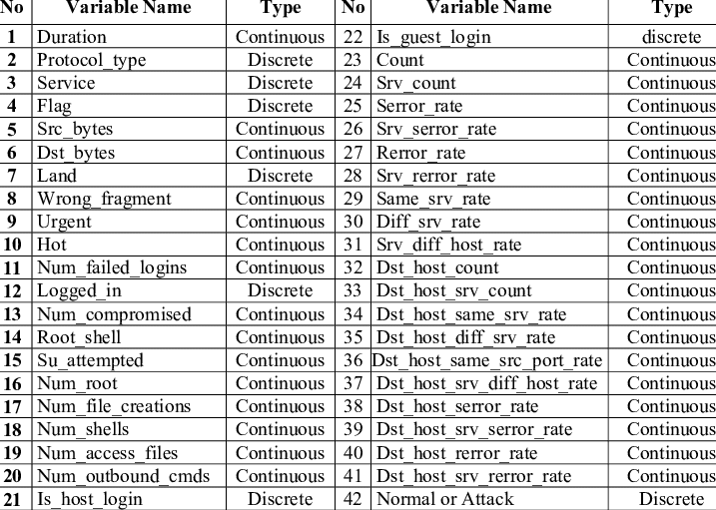
How does the dataset look like?
42 features in total
Including output label

Slide 12
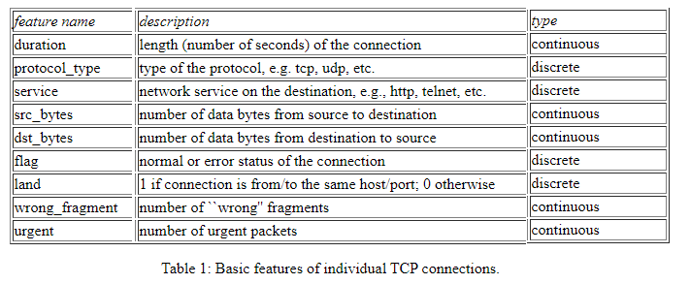
How does the dataset look like?

Slide 13
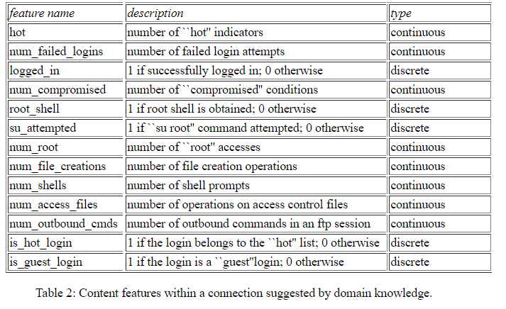
How does the dataset look like?

Slide 14
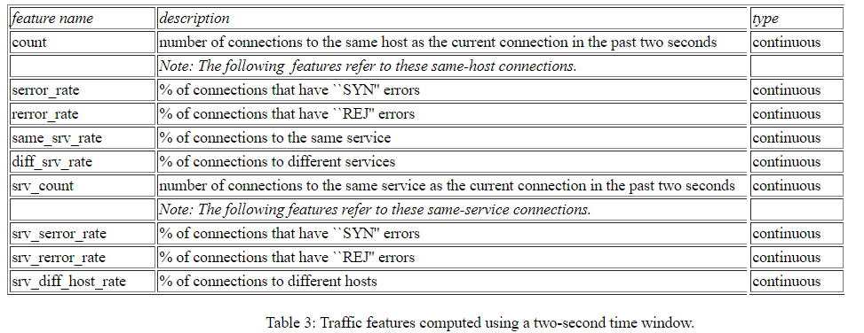
How does the dataset look like?

Slide 15
Question
Do we need to know what each of the features in this dataset actually mean?
We’ll wait till we get to building the machine learning model

Slide 16
Types of attacks : The output we want to predict
Denial of Service (dos): Attacker tries to prevent legitimate users from using a service.
Remote to Local (r2l): Attacker does not have an account on the victim machine, hence tries to gain access.
User to Root (u2r): Attacker has local access to the victim machine and tries to gain super user privileges.
Probe: Attacker tries to gain information about the target host.

Slide 17
Question
What should we predict ?
There is an attack or not (Binary classification)
There is an attack or not. If there is an attack, predict the type of attack as well (Multi class classification. Here 4+1=5 class classification)
There is an attack or not. If there is an attack, predict the subtype of attack as well (Multi class classification. Here 39+1=40 class classification)
That depends on what we want from our model
As the classes to predict increase, the amount of data that we require will also increase
We have performed 5-class classification

Slide 18
Stage 2 completed
Define ML problem
Acquire data
&
explore
Transform the data
Apply ML models
Test your model

Slide 19
Is our dataset ready yet?
Let’s have a look at out dataset once again
There are mostly numeric
or continuous features.
But there are discrete or
categorical features as well.

Slide 20
Is our dataset ready yet?
Computers don’t understand text
We need to come up with something that will convert discrete data to numeric data
How to do that?

Slide 21
Is our dataset ready yet?
We’ll assign each category in categorical feature a number
This is known as Label encoding
e.g.
F1
A
B
C
A
F1
0
1
2
0
A = 0
B = 1
C = 2

Slide 22
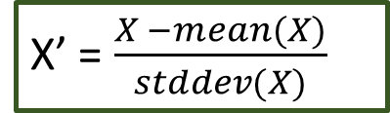
Scaling the numeric data
X’ = $\frac{X −mean(X)}{stddev(X)}$
Not all numeric data are in the same scale.
For e.g. mean value of duration is around 54 and mean value of src_bytes is around 17644
The reason this is an important step is because (a) most model works when data is standardized and (b) data will become unit invariant
We need to bring all the numeric data into same scale. We’ll standardize the data so that the mean is 0 and standard deviation is 1 for each of the numeric features.

Slide 23
Now after we have standardized and encoded the data, we have completed the stage 3
Define ML problem
Acquire data
&
explore
Transform the data
Apply ML model
Test the model

Slide 24
Applying machine learning models
We have implemented 4 machine learning models in this project:
K- nearest neighbour
Naïve Bayes classifier
Logistic regression
Decision tree classifier
And the results of these models are then compared.

Slide 25
K-nearest neighbour
Simple model based on the principle that if two data points are close (here geometrically) , they are similar.
Given a new data point for which we want to find the output, we find points that are distance-wise close to the concerned point.
Whatever is the class label for majority of points in that neighbourhood, that would be the class label for our new data point.
K value decides how many points should we take for neighbourhood

Slide 26
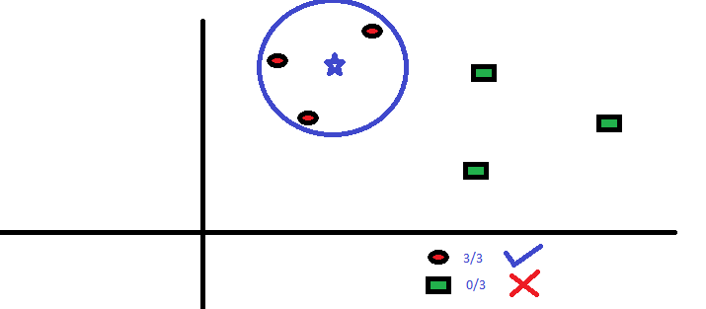
K-nearest neighbour
Here K = 3

Slide 27
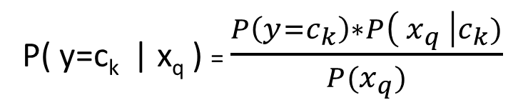
Naïve Bayes classifier
Assumption: Features are conditionally independent
It consists of calculating three things:
1) Prior probabilities (Train stage)
2) Likelihood probabilities (Train stage)
3) Posterior probabilities (Test stage)
likelihood
prior
P( y=c_{k} | x_{q} ) = $\frac{P\left(y=c_{k}\right)∗P\left( x_{q} \right|c_{k})}{P(x_{q})}$
Bayes theorem formula
For conditional probability
posterior

Slide 28
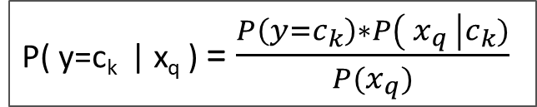
Naïve Bayes classifier
P( y=c_{k} | x_{q} ) = $\frac{P\left(y=c_{k}\right)∗P\left( x_{q} \right|c_{k})}{P(x_{q})}$
1st step : Prior probability
Calculate number of points belonging to each of the classes and then divide with total number of points in the dataset to get respective probabilities of each class
i.e. calculate P(y=c₁) , P(y=c₂) ,…., P(y=c_{k}) if there are k classes

Slide 29
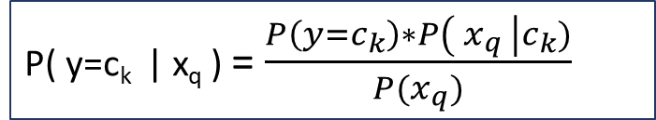
Naïve Bayes classifier
P( y=c_{k} | x_{q} ) = $\frac{P\left(y=c_{k}\right)∗P\left( x_{q} \right|c_{k})}{P(x_{q})}$
2nd step : Likelihood probabilities
For each feature f: P( f | y = c₁ ) , P( f | y = c₂) ,….., P( f | y = c_{k} )
(Use gaussian distribution for continuous features)
3rd step : Posterior probabilities
Put prior and likelihood probabilities in Bayes theorem formula and find out the posterior probabilities for each class (ignoring denominator, as that would be same for all classes)

Slide 30
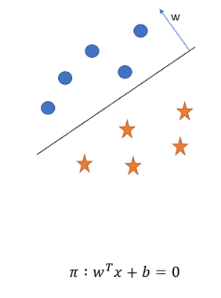

Logistic regression
Assumption: data points are linearly separable
In this we have to find a plane that minimizes the logistic loss
Points in direction of normal (w) will be positive
and opposite to it will be negative
Logistic loss

Slide 31
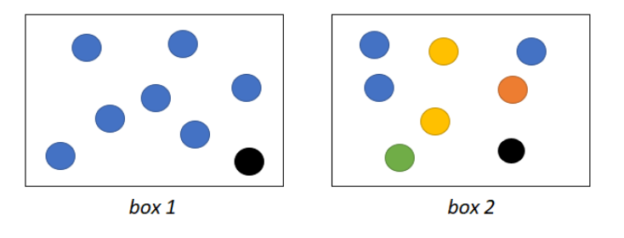
Decision tree classifier
Most likely blue
Difficult to guess
Let’s first talk about entropy
Take a ball from
each of the boxes
and guess the colour
Because Box 1 has less randomness i.e. less entropy

Slide 32
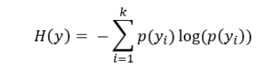
Decision tree classifier
A decision tree would split the data using features in such a way that at each split randomness of data keeps on decreasing.
Randomness or entropy of a system/data is given by:
Where k = number of classes
p(y_{i}) = probability of class y_{i}

Slide 33
Decision tree classifier
Questions
1) How to split the dataset using features?
2) How to select features to split ?

Slide 34
Decision tree classifier
How to split the data?
Procedure:
check one by one by splitting using each feature of the dataset
the one which results in greatest decrease in entropy of system would be chosen to split the dataset.

Slide 35
Decision tree classifier
How to split the data?
There are mainly two types of features in a dataset: Categorical and Numeric
Let f1 be a categorical feature
Dataset
f1 | f2 | output
A | - | 1
B | - | 0
C | - | 1
E_{initial}
f1 = A
f1 = B
f1 = C
D1
D3
D2
E₁
E₂
E₃
For feature f₁ : E_{initial} - weighted_sum (E₁, E₂, E₃ )

Slide 36
Decision tree classifier
Dataset
How to split the data?
Let f1 be a numeric feature
f1 ≤ 2.4
f1 > 2.4
D1
D2
f1 | f2 | output
2.4 | - | 1
2.8 | - | 0
3.2 | - | 1
Dataset
Dataset
f1 ≤ 2.8
f1 > 2.8
f1 ≤ 3.2
f1 > 3.2
D1
D2
D1
D2

Slide 37
Decision tree classifier
What next ?
Continue splitting until all features are used or no further splitting required
The tree generated in this process would be our decision tree model
Query point
Dataset
To predict output of a query point , we traverse the tree and reach to a leaf node.
Majority voting done on the leaf node will decide the output of the query point
D1
D2
D3
D4
D4
D5
Majority voting

Slide 38
We’ve looked at all the models that will be used in our project
Now coming back to the question
Do we need to know what each of the features in this dataset actually mean?
It is always good to know what each of the features mean. This will help in deciding which features are relevant to our objective
But we could also perform feature selection which would help us select features based on their importance

Slide 39
Feature importance
features
f₁
f₂
f₃
accuracies
a1
a2 (max)
a3
f₂ > f₁ > f₃
features
f₂ f₁
f₂ f₃
Once the feature importance of each feature is
known, we can select top features out of them
accuracies
a21 (max)
a23
features
f₂ f₁ f₃
accuracies
a213

Slide 40
We’re done with stage 4 and now we’re ready to test our models
Define ML problem
Acquire data
&
explore
Transform the data
Apply ML model
Test the model

Slide 41
Testing the model
Build model using this
Train data (preferred 70%)
Check model’s performance using this
Test data (preferred 30%)
Dataset

Slide 42
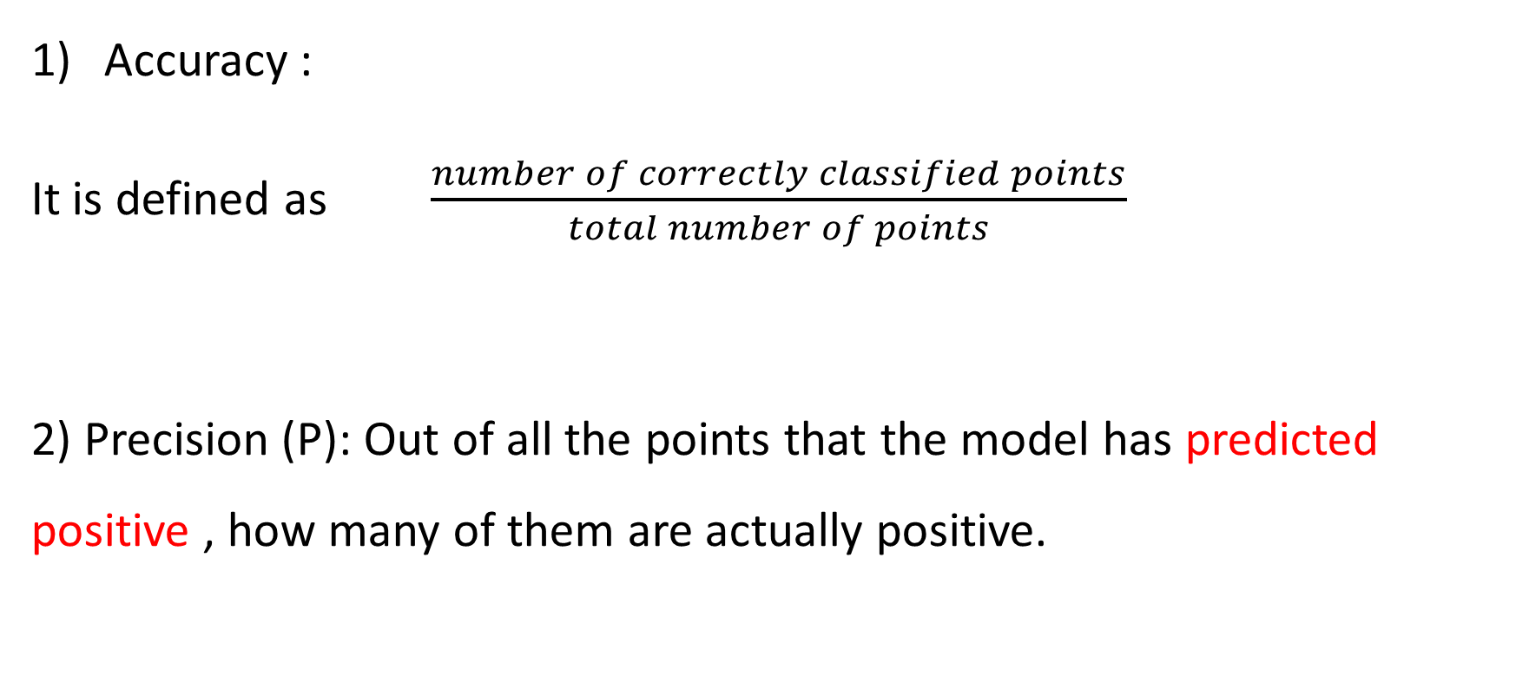
Metrics to check performance of model
Accuracy :
It is defined as $\frac{number of correctly classified points}{total number of points}$
2) Precision (P): Out of all the points that the model has predicted positive , how many of them are actually positive.

Slide 43
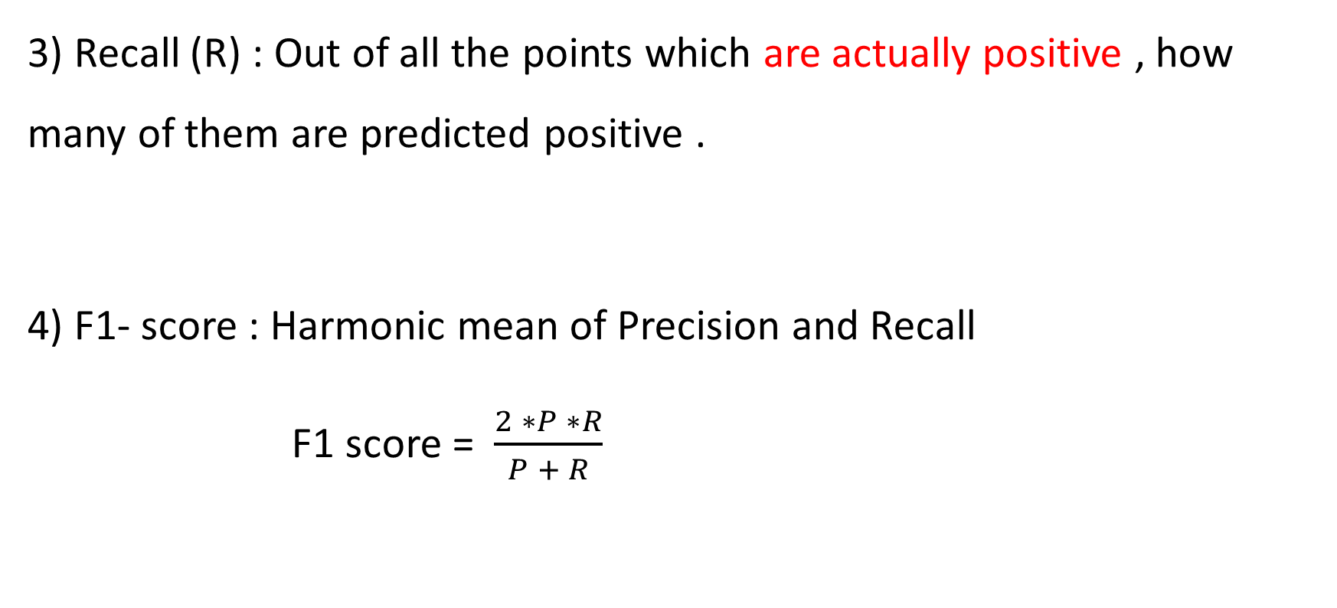
Metrics to check performance of model
3) Recall (R) : Out of all the points which are actually positive , how many of them are predicted positive .
4) F1- score : Harmonic mean of Precision and Recall
F1 score = $\frac{2 ∗P ∗R}{P + R}$

Slide 44
Results obtained
Model | Accuracy | Macro-precision | Macro-recall | Macro-F1-Score
K-nearest neighbour | 0.989 | 0.80 | 0.76 | 0.74
Naïve Bayes | 0.9103 | 0.43 | 0.72 | 0.42
Logistic regression | 0.996 | 0.73 | 0.69 | 0.71
Decision Tree | 0.9994 | 0.97 | 0.87 | 0.91

Slide 45
Conclusion
Although all the classifiers results in 90+ accuracy, but accuracy may not be the best metric to evaluate them as accuracy loses its meaning when we deal with imbalanced dataset
A single metric macro f1 score is used here to compare models
Among the four classifiers, decision tree performed the best

Slide 46
Now we’re done with out last stage
Define ML problem
Acquire data
&
explore
Transform the data
Apply ML model
Test the model

Slide 47
Future scope
With advancement in technology, there is always a need of better ways to deal with network attacks
Work to be done on newer datasets
Nowadays, a lot of research is being done on IDS using deep learning models.
There is no perfect model. IDS that are currently used are a combination of different models
There will always be a search for a model that requires less time but produces good results.

Slide 48
THANK YOU

